Slide 1


MEDIA KIT

Slide 2




Our Values
SuretyBonds.com provides efficient, innovative and informed surety bond solutions nationwide.
Put People First
We are great because our people are great. We owe our success to our people: the ones driving our business and the ones choosing to work with us. We strive to recognize this every day.
Innovate and Simplify
We were born out of a need for a faster, easier and more modern solution. Our lean methodologies and dedication to streamlined workflows allows us to accomplish more with less.
Grow Through Education
No one knows our product better than we do. We are the industry authority, which means more than providing a quick and easy purchase. It means providing a well-informed purchase.
Obsess Over Service
With many options available to customers, we understand that business and respect must be earned. We’re committed to delivering the best experience possible.

Slide 3
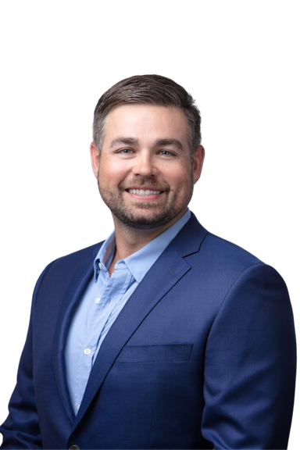
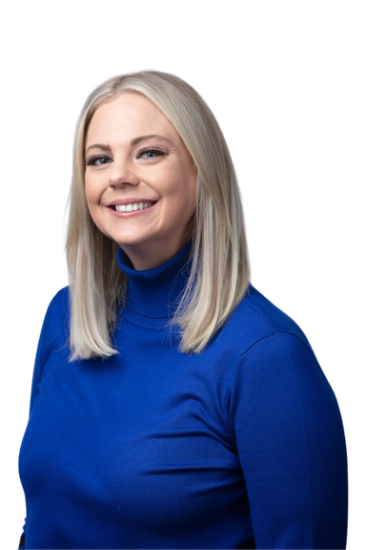
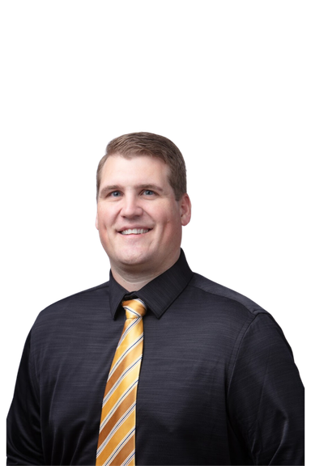



Leadership
Josh Kayser
Founder and Chief Executive Officer
Since founding SuretyBonds.com in 2009, Josh
has led and grown the company — fostering its path to prominence and distinction within the surety industry.
Danielle Burrow
Chief Operations Officer
From the beginning, Danielle has played a key role in shaping the SuretyBonds.com digital presence, scaling operations and driving initiatives that benefit clients, employees and the bottom line.
Brad Bullerdieck
Chief Production Officer
With numerous years of experience in the surety industry, Brad is well-equipped to maximize the effectiveness of bonding solutions and coordinate day to day customer day-to-day interactions.
Contact Us!
1 (800)308-4358
customercare@suretybonds.com
803 E. Walnut St., 5th Floor, Columbia, MO 65201
Learn more at suretybonds.com/about

Slide 4
Company History
2009
CEO and founder
Josh Kayser purchased
the SuretyBonds.com
domain on March 13th, 2009.
2010
In June, we
issued our first
surety bond and became
a fully-functioning agency.
2016
We launched our online
purchase portal and
became the first provider to offer
bonds without application.
2019
We reached 50
employees, which
marked a significant milestone in our company growth.
2021
We published a FAQ knowledge base to
answer common client questions 24/7.
2022
We launch Express
Leads, an agentless,
instant bond quote
capability that reduced
underwriting waiting times.
2023
We moved to a
new office in downtown Columbia, the #SuretySkyline.
2024
We earned 15,000
reviews in 15 years
and continue to maintain an “Excellent” rating on TrustPilot.

Slide 5
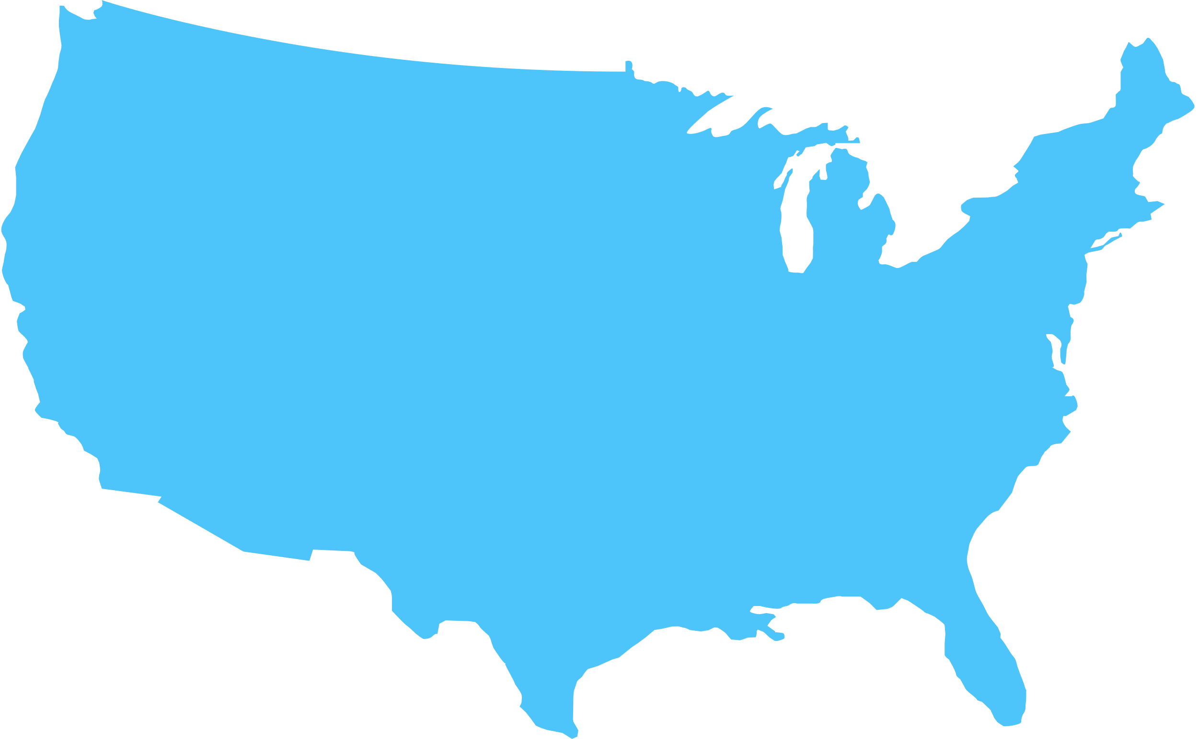




Statistics
Licensed in all 50 states
600,000+ Bonds Issued
70% Instant Purchase* Bonds
*flat rate with no application required
19,000+ Reviews
400,000 + Customers
4.9 Star
Rating Average

Slide 6

Testimonials
"SuretyBonds.com is the real deal. We needed a bond to start a travel agency and were being declined at other places because of the owner’s credit history. They got us the bond at a much better rate."
JONATHAN MORRIS
LEGATO TRAVEL
"I've had nothing but wonderful experiences with SuretyBonds.com. I cannot say enough good things about this company and highly recommend it to anyone who, like myself, is strapped for time."
AARON REANEY
RTS FINANCIAL GROUP, LLC
"What a great company! I was in need of a quick turn-around for a bond, and they hooked me up in very short order. I felt like I was their only customer, and that is a rare gift! "
WINONA BONTRAGER
LANCASTER SCHOOL OF MASSAGE, LLC

Slide 7



Highlights
1st surety agency to sell instant issue bonds
Small Business Administration Accredited
A+ Better Business Bureau (BBB) rating

Slide 8





Branding
Logos
Color Palette
#4ec5fa
#0f172a
#ffffff
Typography
H1, H2: Poppins SemiBold
H3 and Body: Poppins Normal

